Slide 1


GOODCABS’ PERFORMANCE ANALYSIS
Domain : Transpotation & Mobility
Function : Operations
By Rumpi Das

Slide 2
About Goodcabs
Goodcabs , a cab service company established two years ago, has gained a strong foothold in the Indian market by focusing on tier-2 cities. Unlike other cab service providers, Goodcabs is committed to surporting local drivers, helping them make a sustainable living in their hometown while ensuring excellent service to passengers.

Slide 3
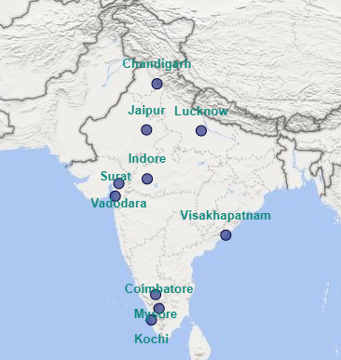


Problem Statement
Goodcabs have been operating in ten tire-2 cities across India for two years, but still, they have not penetrated market.
Goodcabs have set ambitious performance targets for 2024 to drive growth and improve passenger satisfaction.
As part of this initiative, the Goodcabs management team aims to assess the company’s performance across key metrics, including trip volume, passenger satisfaction, repeat passenger rate, trip distribution, and balance between new and repeat passengers.

Slide 4


Detaset Overview
trips_db
targets_db
dim_city
city_target_passenger_rating
dim_date
monthly_target_trips
dim_repeat_trip_distribution
monthly_target_new_passengers
fact_passenger_summary
fact_trips

Slide 5
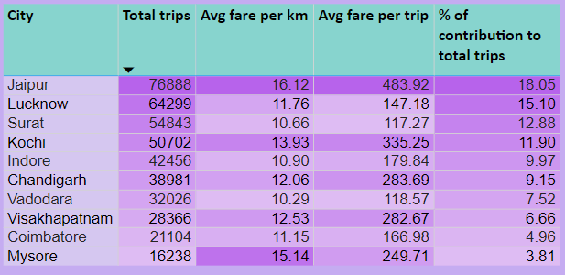
Ad-hoc request :
City-level fare and Trip Summary Report
Generate a report that displays the total trips, average fare per k.m. , average fare per trip and the percentage contribution of each city’s trips to the overall trips. This report will help in assessing trip volume, pricing efficiency and each city’s contribution to the overall trip count.
Key Insights:
Top Cities by Total Trips: Jaipur, Lucknow, and Surat lead in total trips and contribution to overall trips, indicating high customer demand in these cities.
Average Fare per Kilometer: Jaipur, Mysore, and Kochi rank highest, possibly due to longer trip distances or premium pricing.
Average Fare per Trip: Jaipur, Kochi, and Chandigarh are the top performers, reflecting high-value trips in these cities.
t
Conclusion: Jaipur stands out as the top-performing city across all metrics, showcasing strong demand and premium pricing. Lucknow and Surat also contribute significantly to trip volumes, while Kochi and Chandigarh excel in fare-based metrics. These insights can guide city-specific strategies to optimize pricing, enhance service quality, and boost demand.

Slide 6
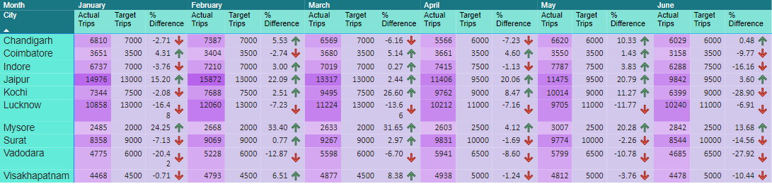
Ad-hoc request :
2. Monthly City-level Trips Target Performance report
Generate a report that evaluates the target performance for trips at the monthly and city level. For each city and month, compare the actual total trips with the target trips, categorised the performance. Additionally, calculate the % difference between actual and target trips to quantify the performance gap.
Key Insights:
Top Performers: Jaipur and Mysore met their trip targets consistently for all six months.
Underperformers: Vadodara and Lucknow failed to meet their trip targets in every month, indicating room for improvement in these cities.
Conclusion:
Cities like Jaipur and Mysore showcase exemplary performance, while cities like Vadodara and Lucknow require targeted interventions to boost trip volumes and align with their goals.

Slide 7
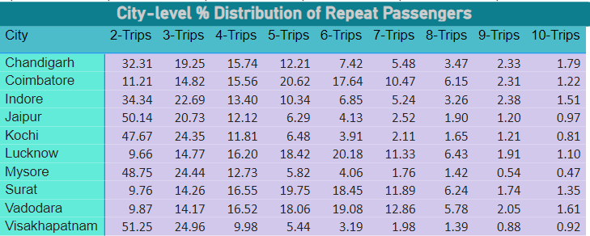
Ad-hoc request :
3. City-level Repeat Passenger trip Frequency Report
Generate a report that shows the percentage distribution of repeat passengers by the numberof trips they have taken in each city. Calculate the percentage of repeat passengers who took 2-trips, 3-trips and so on up to 10-trips. Each column should represent a trip count category,displaying the percentage of repeat passengers who fall into that category out of the total repeat passengers for all that city.
Key Insights:
High Contribution: Passengers with smaller trip counts (e.g., 2 or 3 trips) dominate the repeat passenger distribution.
Low Contribution: Passengers with higher trip counts (e.g., 9 or 10 trips) have the smallest share, indicating lower retention over time.
Conclusion:
Goodcabs can focus on strategies to nurture repeat passengers in lower trip count categories, such as loyalty programs and personalized offers, to increase their engagement and encourage more frequent usage.

Slide 8
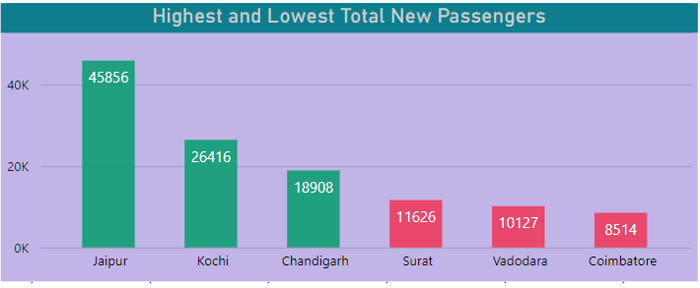
Ad-hoc request :
4. Cities with Highest and Lowest Total New Passengers.
Generate a report that calculates the total new passengers for each city and ranks them based on this value. Identify the top 3 cities with highest number of new passengers as well as the bottom 3 cities with the lowest number of new passenger, categorising them as “Top 3"or ”Bottom 3" accordingly.
Key Insights:
Top Performers: Jaipur, Kochi, and Chandigarh rank as the top three cities for new passenger acquisition.
Underperformers: Surat, Vadodara, and Coimbatore have the lowest number of new passengers, signaling areas needing improvement.
Conclusion:
While the top cities demonstrate strong growth potential, targeted marketing campaigns and partnerships could help improve passenger acquisition in the bottom-performing cities.

Slide 9
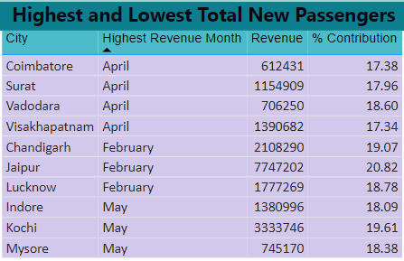
Ad-hoc request :
5. Identify Month with Highest Revenue for each City.
Generate a report that identifies the month with the highest revenue for each city. For each city, display the month name, the revenue amount for that month, and the percentage contribution of that month’s revenue to the cities total revenue.
Highest Revenue Month
Key Insights:
Seasonal Peaks: April drives the highest revenue for four cities, while February and May dominate for others, reflecting varied demand patterns.
City-Specific Trends: Each city has unique revenue peaks, influenced by local events, tourism seasons, or business activities.
Conclusion:
Goodcabs can leverage this data to focus on city-specific marketing efforts and resource allocation during peak months to maximize revenue and customer satisfaction.

Slide 10
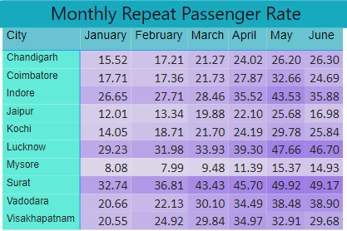
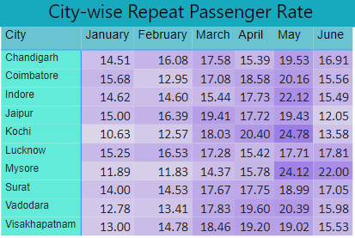
Ad-hoc request :
6. Repeat Passenger Rate Analysis
Generate a report that calculates two metrics:
1. Monthly Repeat Passenger Rate: Calculate the repeat passenger rate for each city and month by comparing the number of repeat passengers to the total passengers.
2. City-wise Repeat Passenger Rate: Calculate the overall repeat passenger rate for each city, considering all passengers across months.
Key Insights:
Top Cities for Repeat Passengers: Lucknow, Indore, Vadodara, and Visakhapatnam lead in monthly repeat passenger rates.
Seasonal Peak: May consistently shows the highest repeat passenger rate across all cities, indicating potential seasonal or event-driven loyalty.
Conclusion:
Strengthening customer engagement efforts, particularly in May and in high-performing cities, could further enhance repeat passenger rates and overall business growth.

Slide 11
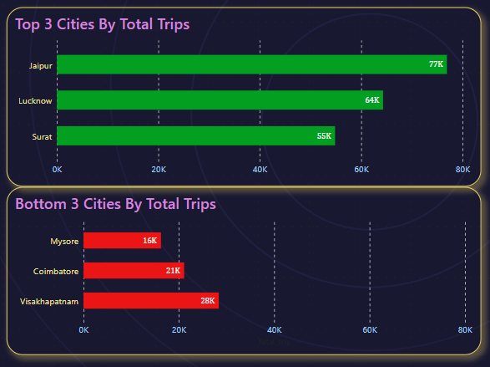
Primary Analysis:
Top and Bottom Performing Cities
Identify the top 3 and bottom 3 cities by total trips over the entire analysis period.
Key Insights:
High Performers: Jaipur, Lucknow, and Surat excel in total trips, indicating strong market presence.
Low Performers: Mysore, Coimbatore, and Visakhapatnam struggle with trip volumes, highlighting areas for improvement.
Conclusion:
Goodcabs should focus on maintaining momentum in top-performing cities while implementing targeted strategies to improve demand and operations in the bottom three cities.

Slide 12
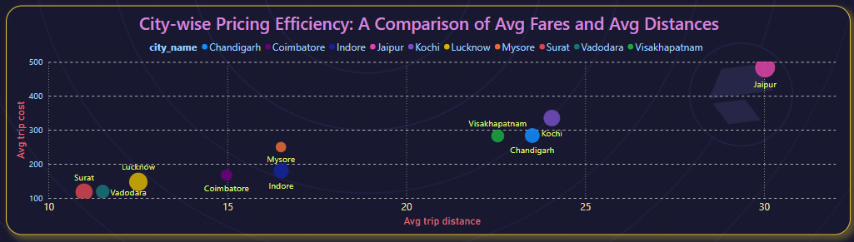
Primary Analysis:
2.Average Fare Per Trip By Cities
Calculate the average fare per trip for each city and compare it with the city's average trip distance. Identify the cities with the highest and lowest average fare per trip to assess pricing efficiency across locations.
Key Insights:
High Pricing Efficiency: Jaipur achieves the highest average fare per trip, correlating with the longest average trip distances.
Low Pricing Efficiency: Surat has the lowest average fare per trip, matching its shorter average trip distances.
Conclusion:
Jaipur's pricing model appears optimal for its demand and trip characteristics, while Surat may require a review of its pricing strategy to improve revenue potential.

Slide 13
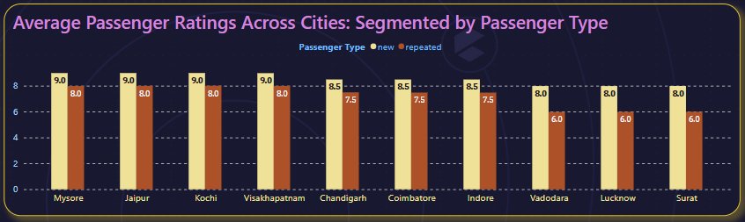
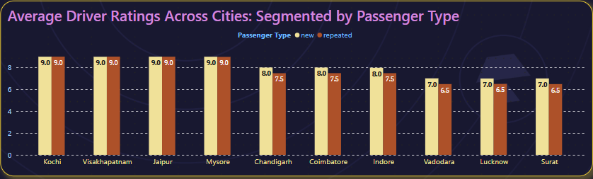
Primary Analysis:
3.Average Ratings by City and Passenger Type
Calculate the average passenger and driver ratings for each city, segmented by passenger type (new vs. repeat). Identify cities with the highest and lowest average ratings.
Key Insights:
1.Highest Average Rating Cities:
Jaipur, Mysore, Kochi and
Visakhapatnam are the Cities
with highest average rating.
2.Lowest Average Rating Cities:
Surat, Lucknow, Vadodara are
the cities with lowest average
rating.
Conclusion:
New passengers provide higher ratings consistently across all cities compared to repeat passengers.

Slide 14
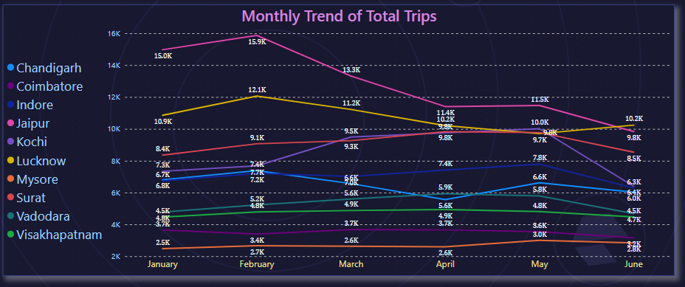
Primary Analysis:
4. Peak and Low Demand Months by City
For each city, identify the month with the highest total trips (peak demand) and the month with the lowest total trips (low demand). This analysis will help Goodcabs understand seasonal patterns and adjust resources accordingly.
Key Insights:
Peak Demand Month: February shows the highest trip volumes in Jaipur, Chandigarh, and Lucknow, indicating strong seasonal or event-based demand.
Low Demand Management: Understanding low-demand months can help optimize costs and resources during quieter periods.
Conclusion:
This analysis highlights the importance of adapting strategies to meet demand peaks while addressing low-demand periods efficiently to maintain operational balance and profitability.

Slide 15
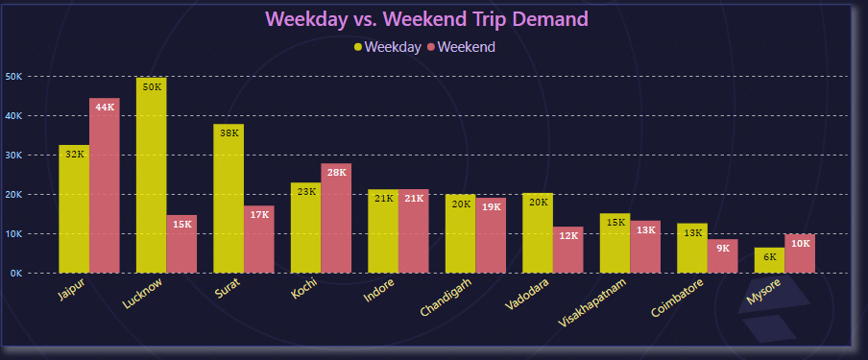
Primary Analysis:
5. Weekend vs. Weekday Trip Demand by City
Compare the total trips taken on weekdays versus weekends for each city over the six-month period. Identify cities with a strong preference for either weekend or weekday trips to understand demand variations.
Key Insights:
Cities like Jaipur, Kochi, and Mysore show stronger demand for weekend trips, likely influenced by leisure and tourism activities.
Weekday Preference: Cities such as Lucknow, Surat, Vadodara, Visakhapatnam, and Coimbatore have higher weekday trip volumes, suggesting a focus on business or daily commuting.
Conclusion:
Understanding these patterns can help Goodcabs align its operations by optimizing fleet allocation and designing city-specific marketing strategies to capitalize on demand variations.

Slide 16
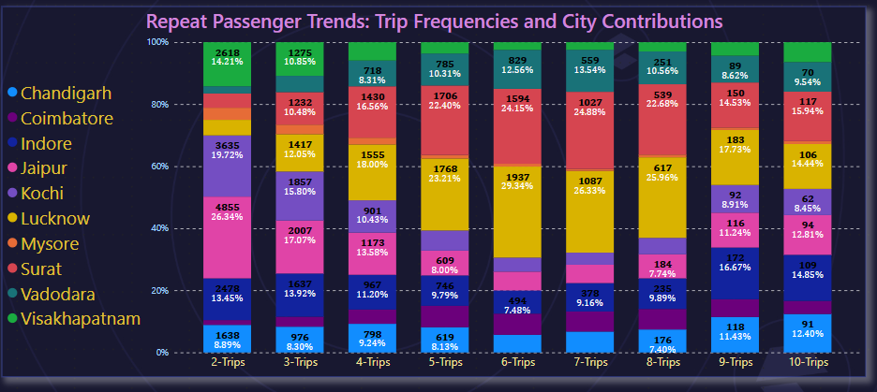
Primary Analysis:
6.Repeat Passenger Frequency and City Contribution Analysis
Analyse the frequency of trips taken by repeat passengers in each city (e.g., % of repeat passengers taking 2 trips, 3 trips, etc.). Identify which cities contribute most to higher trip frequencies among repeat passengers, and examine if there are distinguishable patterns between tourism-focused and business-focused cities.
Key Insights:
Small Frequency Trips: Jaipur, Kochi, and Visakhapatnam dominate in smaller trip frequencies, consistent with their tourism-driven demand.
High Frequency Trips: Indore, Chandigarh, and Lucknow lead in higher trip frequencies, indicating a strong business or daily commuting trend.
Conclusion:
This analysis highlights distinct travel patterns based on city profiles, which Goodcabs can leverage to tailor services, such as loyalty programs for high-frequency business travelers and promotional packages for leisure travelers.

Slide 17
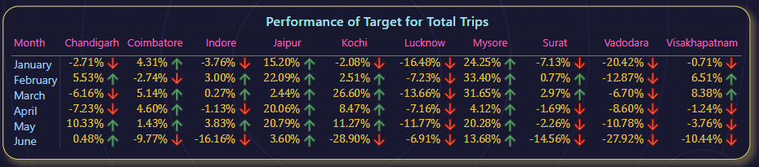
Primary Analysis:
7. Monthly Target Achievement Analysis for Key Metrics
For each city, evaluate monthly performance against targets for total trips, new passengers, and average passenger ratings from targets_db. Determine if each metric met, exceeded, or missed the target, and calculate the percentage difference. Identify any consistent patterns in target achievement, particularly across tourism versus business-focused cities.
Key Insights:
Consistent High Performers: Jaipur and Mysore met their target for trips across all the six months, indicating strong customer satisfaction.
Persistent Underperformance: Chandigarh, Visakhapatnam, Indore, Coimbatore, Surat, Lucknow, and Vadodara fell short, highlighting areas for improvement in customer experience.

Slide 18
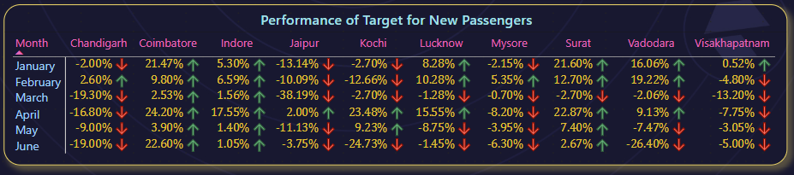
Primary Analysis:
7. Monthly Target Achievement Analysis for Key Metrics
Strong Performers: Coimbatore and Indore have consistently met their new passenger targets, reflecting successful efforts in attracting and retaining new riders.
Inconsistent Performance: Jaipur, Chandigarh, Mysore, and Visakhapatnam have met their new passenger targets only for one month, pointing to variability in passenger growth that may need more focused strategies.

Slide 19
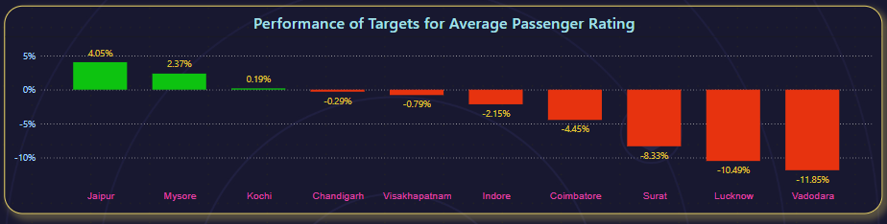
Primary Analysis:
7. Monthly Target Achievement Analysis for Key Metrics
Key Insights:
High Performers: Jaipur, Mysore, and Kochi met their target ratings, indicating strong customer satisfaction.
Low Performers: Chandigarh, Visakhapatnam, Indore, Coimbatore, Surat, Lucknow, and Vadodara fell short, highlighting areas for improvement in customer experience.

Slide 20
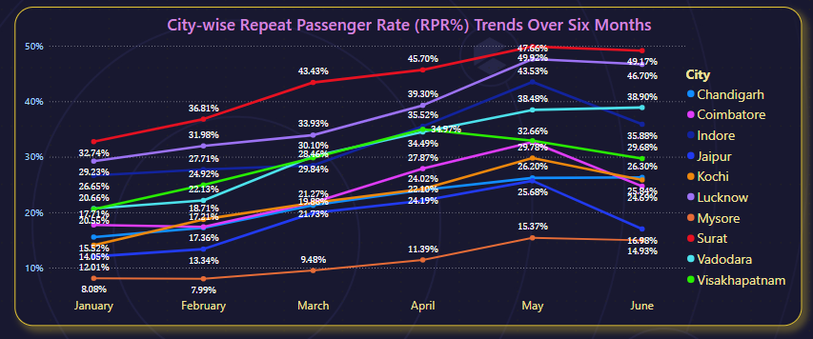
Primary Analysis:
8.Highest and Lowest Repeat Passenger Rate(RPR%) by City and Month
Analyse the Repeat Passenger Rate (RPR%) for each city across the sixmonth period. Identify the top 2 and bottom 2 cities based on their RPR% to determine which locations have the strongest and weakest rates.
Key Insights:
Highest Repeat Passenger Rate (RPR):
Surat stands out with the highest repeat passenger rate across all six months, reflecting a high level of customer retention and satisfaction. This indicates that passengers in Surat are more likely to choose Goodcabs repeatedly, suggesting effective service and loyalty-building strategies.
Lowest Repeat Passenger Rate (RPR):
Mysore has shown the lowest RPR percentage trend across all six months. This highlights a potential challenge in retaining passengers, suggesting that more efforts may be needed to increase repeat usage in this city. Factors like customer experience, promotional offers, or service quality could be areas to explore for improvement.

Slide 21
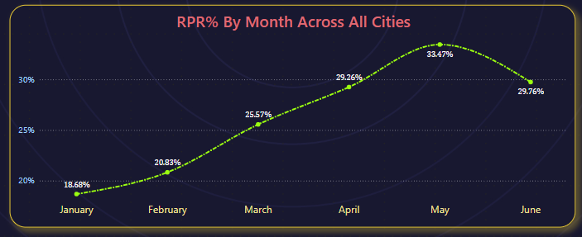
Primary Analysis:
8.Highest and Lowest Repeat Passenger Rate(RPR%) by City and Month
Similarly, analyse the RPR% by month across all cities and identify the months with the highest and lowest repeat passenger rates. This will help to pinpoint any seasonal patterns or months with higher repeat passenger loyalty.
Key Insights:
Seasonal Trends in RPR:
January shows the lowest repeat passenger rate (RPR%), indicating weaker customer loyalty during this month. This could be influenced by factors such as lower demand or external circumstances affecting repeat ridership.
May exhibits the highest RPR%, suggesting stronger repeat passenger loyalty. This could be attributed to factors like favorable weather, holidays, or effective promotions during this time.

Slide 22
Secondary Insights Report
1. Factors Influencing Repeat Passenger Rates:
Key Factors: Service quality, competitive pricing, city demographics.
Insights: Tourism-heavy cities (Jaipur, Mysore) have lower repeat rates; business cities (Lucknow, Surat) see higher repeat usage.
Recommendation: Improve service and pricing in tourism cities; introduce loyalty programs in business cities.
2.Tourism vs. Business Demand Impact:
Insights: Tourism cities see weekend spikes (Jaipur, Mysore); business cities see weekday demand (Lucknow, Surat).
Recommendation: Launch seasonal promotions for tourism cities; target business events for consistent demand.
3. Emerging Mobility Trends and Goodcabs' Adaptation:
Trends: EV adoption, ride-pooling, green initiatives.
Recommendation: Gradually integrate EVs, offer shared rides, and promote sustainability for competitive advantage.
4. Partnership Opportunities with Local Businesses
Potential Partners: Hotels, malls, event venues.
Benefits: Boost demand, improve loyalty, enhance visibility.
Recommendation: Collaborate with high-footfall businesses and co-brand campaigns for events.

Slide 23
Secondary Insights Report
5. Data Collection for Enhanced Decisions
Customer Behavior Data:
Collect optional data like age, gender, and income brackets to segment customers.
Capture preferred booking times, destinations, and ride frequencies.
Identify high-demand zones (e.g., airports, malls) and peak periods (weekends, festivals).
Track repeat passengers’ booking patterns and spending habits.
Market Trends Data:
Monitor pricing, promotions, and service features of competitors in tier-2 cities.
Collect data on upcoming festivals, conferences, and tourism trends.
Track fuel prices, local GDP growth, and disposable income levels.
Booking and Cancellation Data:
Capture reasons for ride cancellations and booking issues.
Address service gaps to improve booking success rates.

Slide 24
Conclusion
The performance analysis of Goodcabs across its 10 tier-2 cities highlights significant variations in operational metrics and city-specific trends:
Top Performers
Jaipur: The undisputed leader across multiple metrics, including total trips, total revenue, and new passenger acquisition.
Kochi: The second-highest in total revenue and average fare per trip, indicating a strong revenue generation despite being in 4th place for total trips.
Lucknow: The second-highest in total trips, showing consistent demand despite being 4th in total revenue.
Underperformers
Coimbatore: Ranks second-lowest in total trips, total revenue, and new passengers, showing a need for strategic intervention.
Mysore: Despite having the lowest total trips, Mysore performs well in average fare per km and consistently meets trip targets, reflecting a stable, albeit small, market.
Vadodara: Consistently among the lowest in total revenue, average fare per km, and new passenger acquisition.

Slide 25
Conclusion
Key Observations
Demand Patterns
Weekend Demand: High in Jaipur, Kochi, and Mysore, likely due to tourism.
Weekday Demand: Dominates in business-oriented cities like Chandigarh, Lucknow, and Indore.
Revenue Peaks
April: Highest revenue for Coimbatore, Surat, Vadodara, and Visakhapatnam.
February: Highest for Chandigarh, Jaipur, and Lucknow.
May: Highest for Indore, Kochi, and Mysore.
Opportunities for Growth
Customer Retention: Jaipur and Lucknow have high trip numbers but relatively low repeat passenger percentages.
Target Achievement: Cities like Vadodara and Lucknow occasionally fail to meet trip targets, suggesting room for optimization.
Revenue Optimization: Mysore’s high average fare per km indicates potential for premium pricing, while cities like Surat and Vadodara may benefit.

Slide 26
Thank you all for your time and attention throughout this presentation. I hope these insights have provided a clear understanding of the analysis and actionable strategies for Goodcabs' growth. Your feedback and questions are most welcome. Thank you once again!
THANKS FOR YOUR TIME

